Slide 1
HIV Treatment Outcomes Analysis and Prediction
Proposed title: Predicting HIV Treatment Outcomes Using Machine Learning
Viral Load Suppression Classification and CD4 Count Estimation
Presented by: Marsha Kiptoo & Lorna Kemboi
Program: Eldo Hub Data Analysis
Dataset period: 2020–2025

Slide 2
Project overview
PRESENTATION OVERVIEW
01. Project Background
Problem Statement and Objectives
02. Data and Preparation
Dataset Description, Cleaning and Preprocessing
03. Data Analysis and Insights
Trends, Patterns and Key Findings
04. Machine Learning
Viral Load Suppression and CD4 Count Prediction
05. Application and Dashboard
Flask Application, Render Deployment and Power BI Dashboard
06. Results and Conclusion
Model Performance, Limitations and Recommendations

Slide 3
Project objectives
Main Objective
Analyze HIV program data to understand factors associated with viral load suppression and CD4 count.
Specific Objectives
Assess patterns in viral load suppression among patients receiving HIV care.
Identify patient and treatment factors associated with viral load suppression.
Develop machine learning models to predict viral load suppression status.
Build regression models to estimate patients’ CD4 counts.
Develop a Flask web application to demonstrate the model predictions.

Slide 4
Dataset Overview
04 | COLLECT — THE DATA
Data Source
Dataset: HIV_Cases_Eldoret_MTRH_Synthetic_2020_2025.csv
Synthetic dataset developed for the capstone project.
Focus: HIV program monitoring and patient outcomes.
Dataset Overview
Original records: 5,205 rows
Variables: 18 columns
Period covered: 2020–2025
Study setting: Eldoret / MTRH
Ethical Considerations
Contains simulated, not verified real patient records.
No real patient identities are represented.

Slide 5
Data Cleaning and Preparation
Why was data cleaning necessary?
The dataset contained inconsistencies that needed to be addressed before exploratory analysis and machine learning.
Key data quality issues and actions
Inconsistent categories
Standardized Gender values, such as F, Female and FEMALE, into consistent categories.
Inconsistent date formats
Converted Registration Date values into a consistent datetime format.
Missing values
Examined missing values and handled them according to the project's cleaning guidelines.
Data integrity checks
Checked CaseID values for missing entries and duplicates.

Slide 6
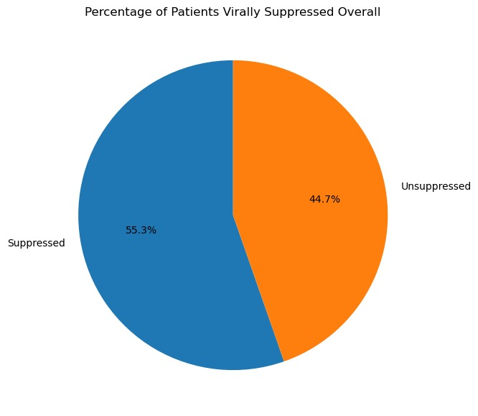
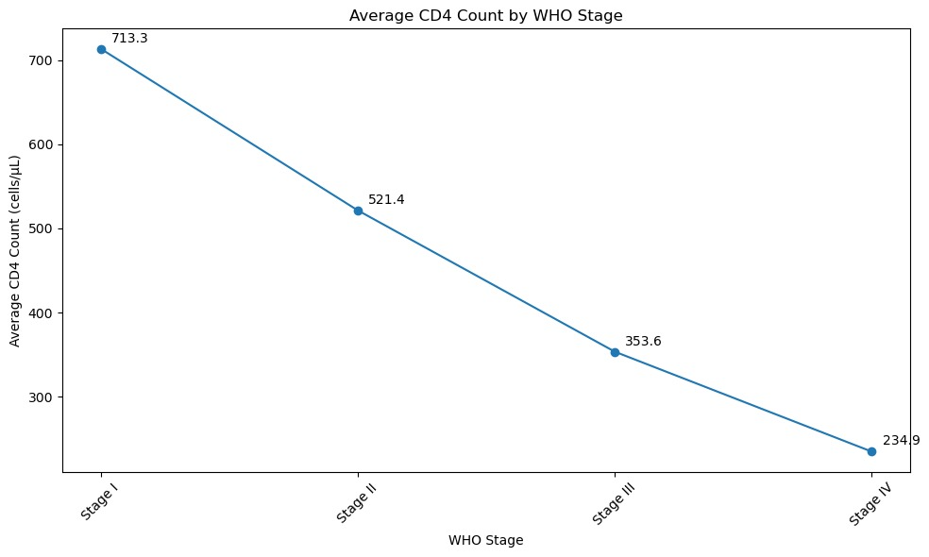
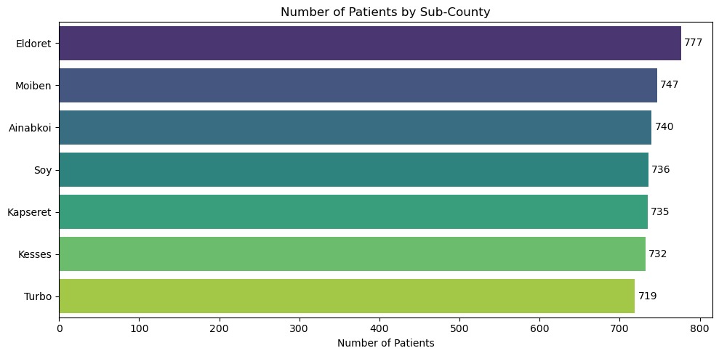
Exploratory Data Analysis
Purpose of EDA

Slide 7
FEATURE ENGINEERING
1. Date Features
Extracted year, month, quarter and day of the week from registration dates.
2. Age and CD4 Categories
Age groups: Pediatric (0–14), Youth (15–24), Adult (25–59) and Older Adult (60+).
CD4 groups: Below 200, 200–349, 350–499 and 500+ cells/µL.
3. Viral Suppression and Clinic Visits
Suppressed: Viral load below 1,000 copies/mL, including LDL results.
Unsuppressed: Viral load of 1,000 copies/mL or higher.
Visit frequency: Low (0–2), Regular (3–5) and High (6+) visits per year.
4. Model Preparation
Encoded categorical variables and scaled numerical features.
Excluded record identifiers from predictive features.

Slide 8
Machine Learning Methods
Predict viral load suppression and estimate CD4 count
Classification
Logistic Regression
Decision Tree
Random Forest (200 trees)
Regression
Linear Regression
Random Forest Regressor
Data Preparation
11 predictor features · Encoding · Missing-value handling · Scaling for Logistic Regression
Validation 80/20 split
80% Training
20% Testing

Slide 9
MODEL EVALUATION AND PERFORMANCE
1. Viral Load Suppression — Classification
Best model: Random Forest
Test accuracy: 86.97%
Recall (Unsuppressed): 96.55%
Precision (Unsuppressed): 78.95%
Limitation: 100% training accuracy suggests possible overfitting.
2. CD4 Count Estimation — Regression
Model | MAE | RSME | R²
Linear Regression | 107.84 | 136.79 | 0.576
Decision Tree | 162.94 | 202.83 | 0.067
Random Forest | 111.48 | 140.58 | 0.552

Slide 10
DEPLOY — MODEL DEPLOYMENT
Platform
Flask web application hosted on Render.
Power BI dashboard for HIV program insights.
Tools Used
Python & scikit-learn: Machine learning.
Flask & Render: Application and hosting.
Power BI & Jupyter Notebook: Visualization and analysis.
How It Works
Users enter patient details.
Models predict viral suppression and estimate CD4 count.
Dashboard displays program trends and outcomes.
Live Application:
https://hiv-program-data-analysis.onrender.com

Slide 11
Limitations
The dataset contains synthetic records, not verified real patient data.
Findings may not reflect actual clinic or population outcomes.
Model predictions require validation on appropriate real-world data before clinical use.
Missing values and data quality may affect analysis.
Predictive performance does not establish causation.

Slide 12
Conclusion
This project demonstrates how HIV program data can be analyzed to explore patient registration trends, sub-county patient loads and viral suppression patterns.
Machine learning models were developed to predict viral suppression and estimate CD4 counts, with a Flask application and Power BI dashboard intended to communicate results and support programme monitoring.
Further validation using appropriate real-world data is required before clinical application.

Slide 13
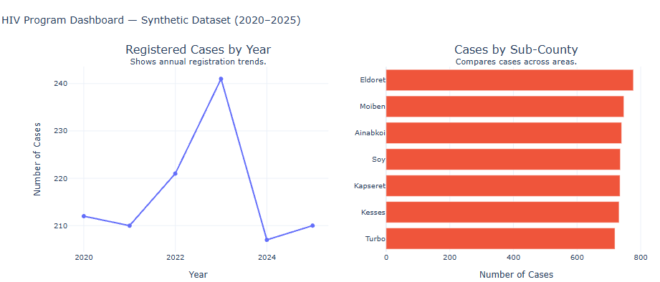
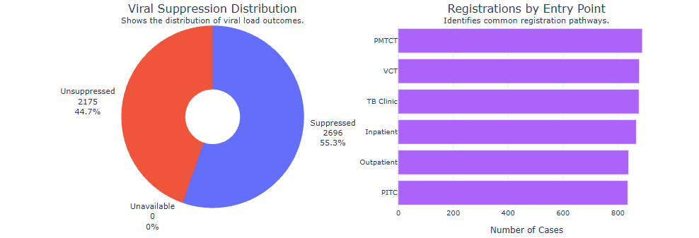
Dashboard-Summary

